Slide 1
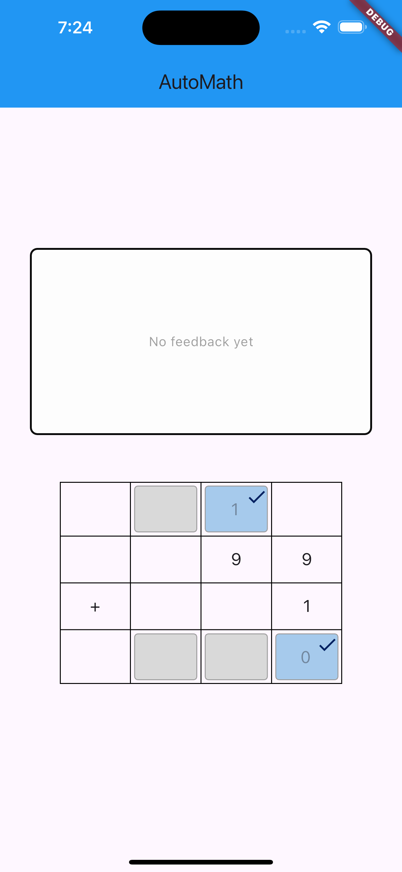
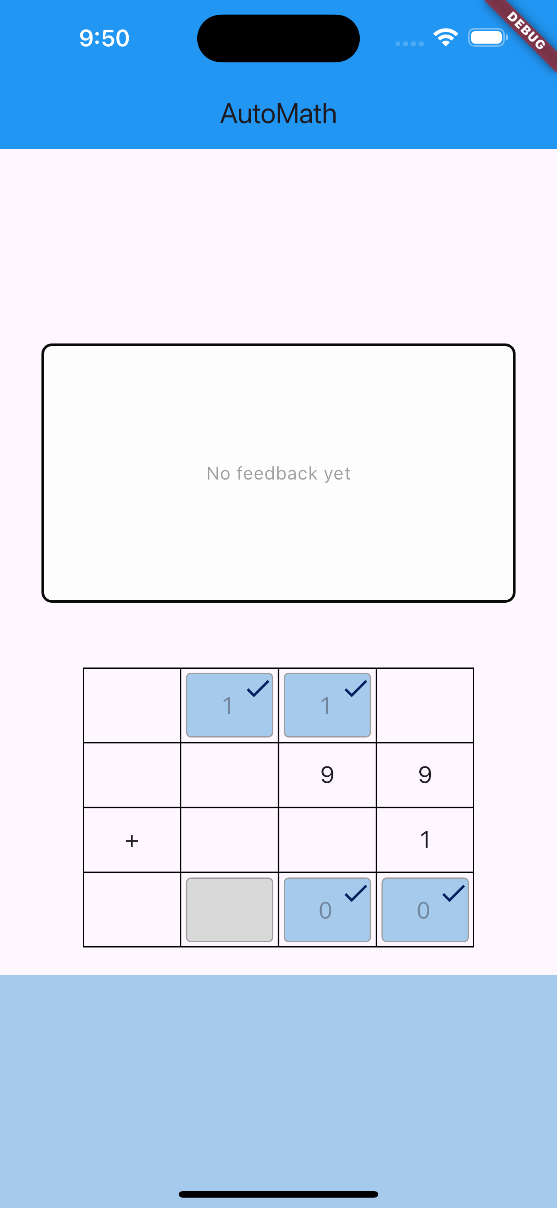
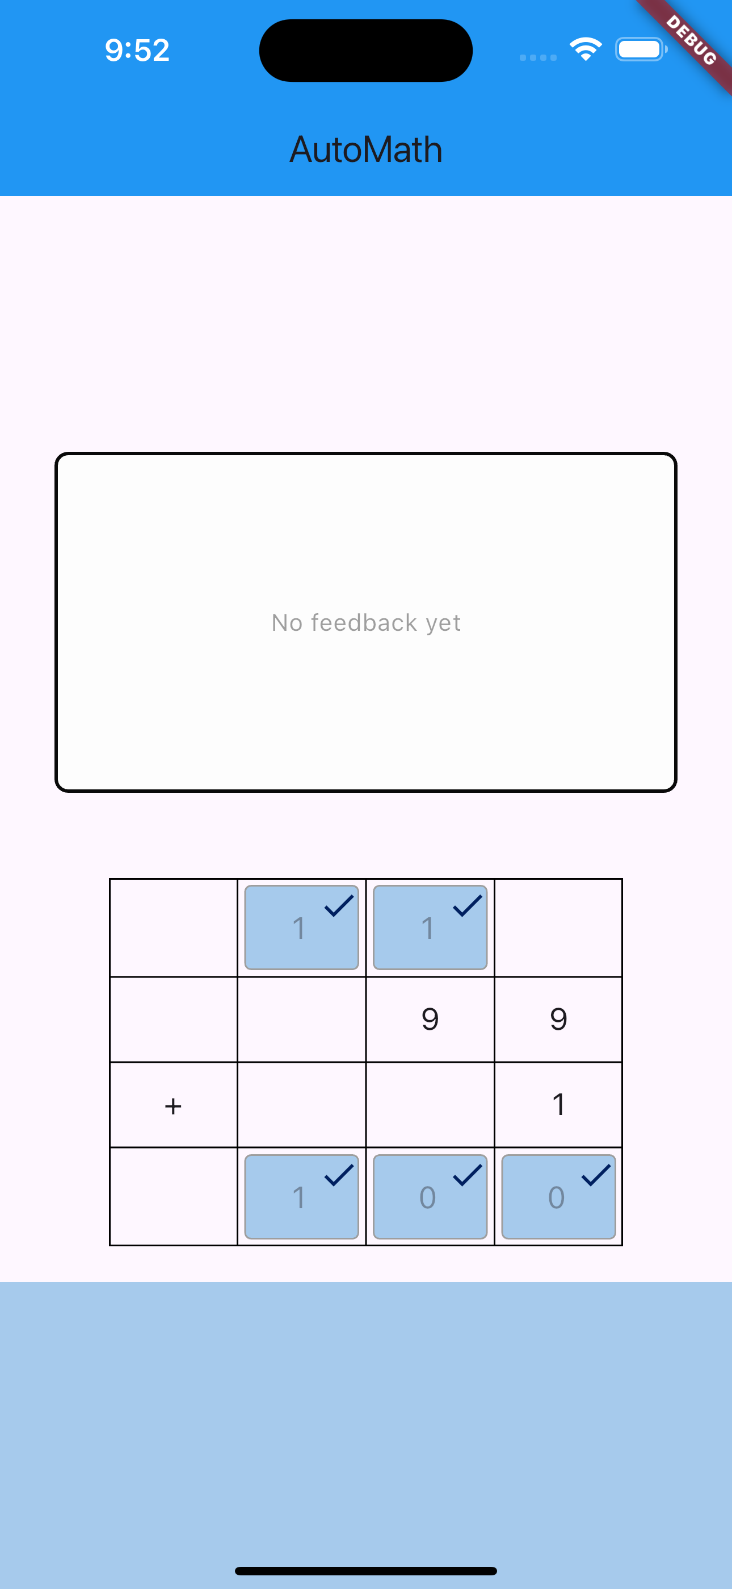

Step 1 Correct
Step 2 Correct
Step 3 Correct
Nice Work!
Nice Work!
Nice Work!
✓
2
3
✓
2
✓
3
✓
2
✓
3
✓

Slide 2
Step 1 Correct
Step 2 Correct
Step 3 Correct
Nice Work!
Nice Work!
Nice Work!
1
2
3
✓
2
3
✓
2
✓
3
✓

Slide 3
1 step correct
2 steps correct
3 steps correct
✓
✓
✓
2
✓
✓
3
✓
Nice Work!
Nice Work!
Nice Work!

